Slide 1
True restaurant reviews
Using Twitter and Zomato to find a restaurants true rating

Slide 2
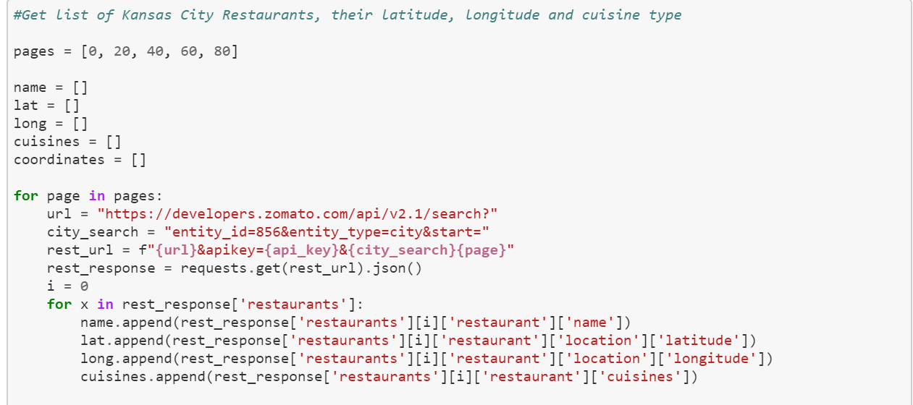
Zomato
Use Zomato API to gather 100 restaurants in the Kansas City area along with their latitude and longitude.

Slide 3
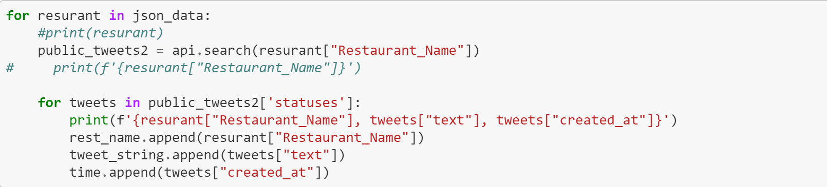
User twitter to gather tweets about restaurant
Use the tweepy API to gather tweets about the restaurant using restaurant name

Slide 4
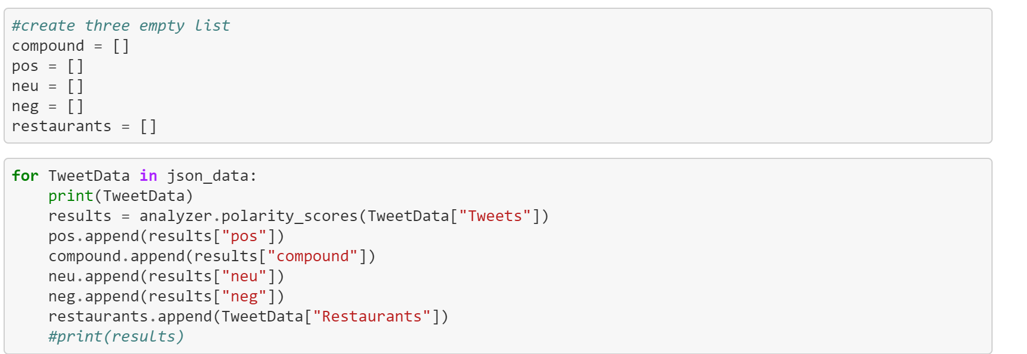
Sentiment analysis
Use Vader analysis to get the sentiment of the tweets

Slide 5
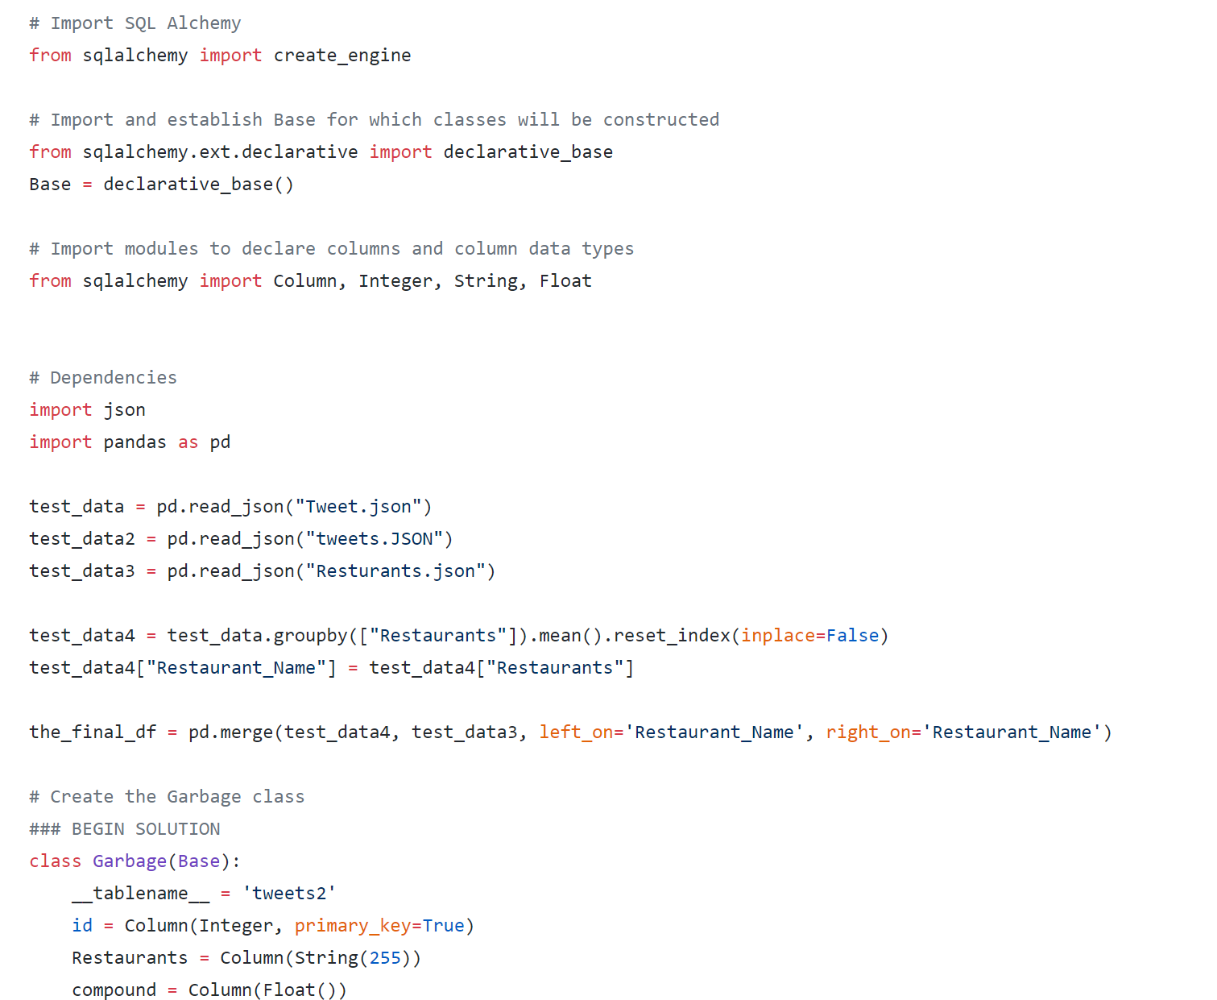
Create Sql database
- Use SQLAlchemy to create a database.

Slide 6
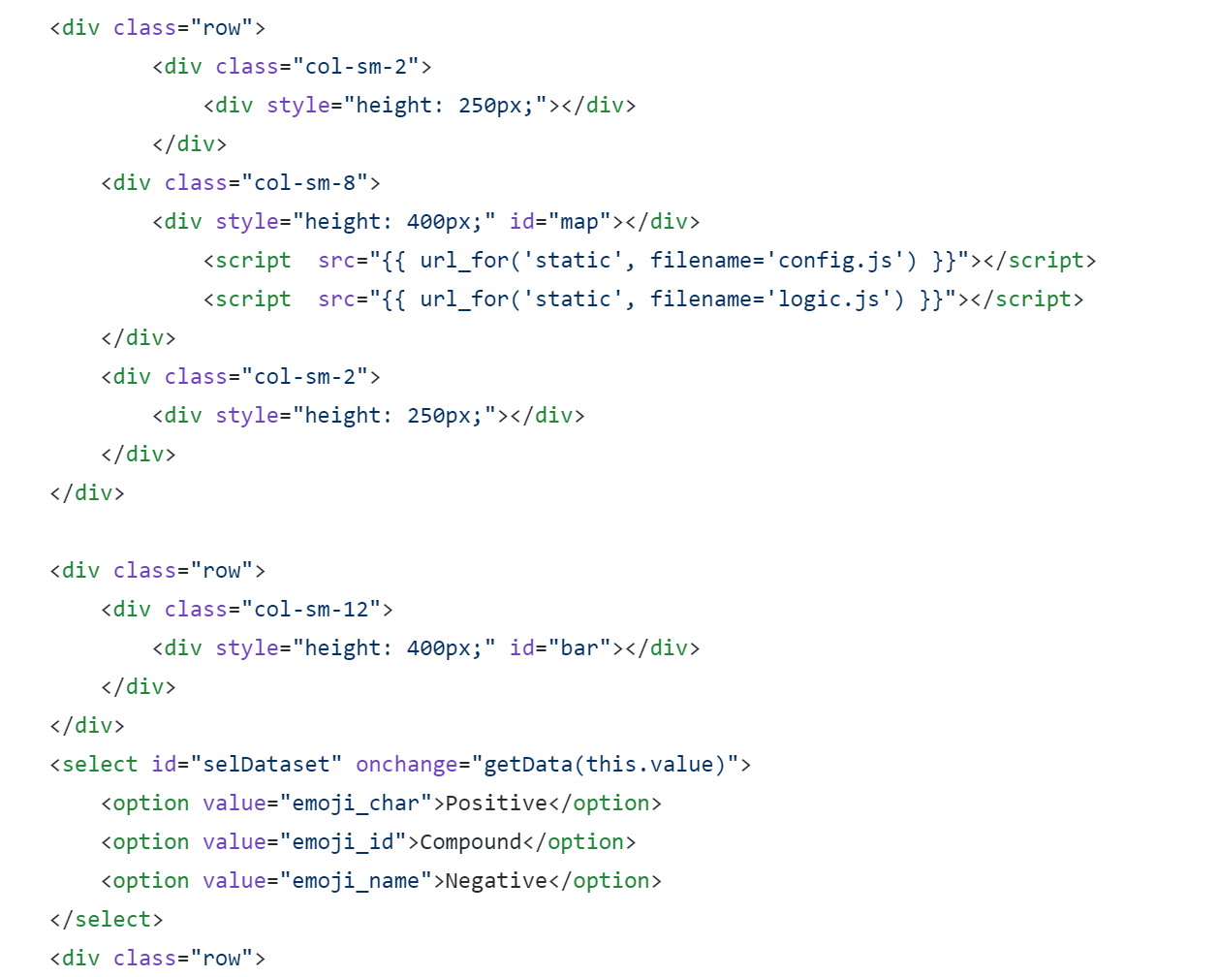
Creating the chart

Slide 7
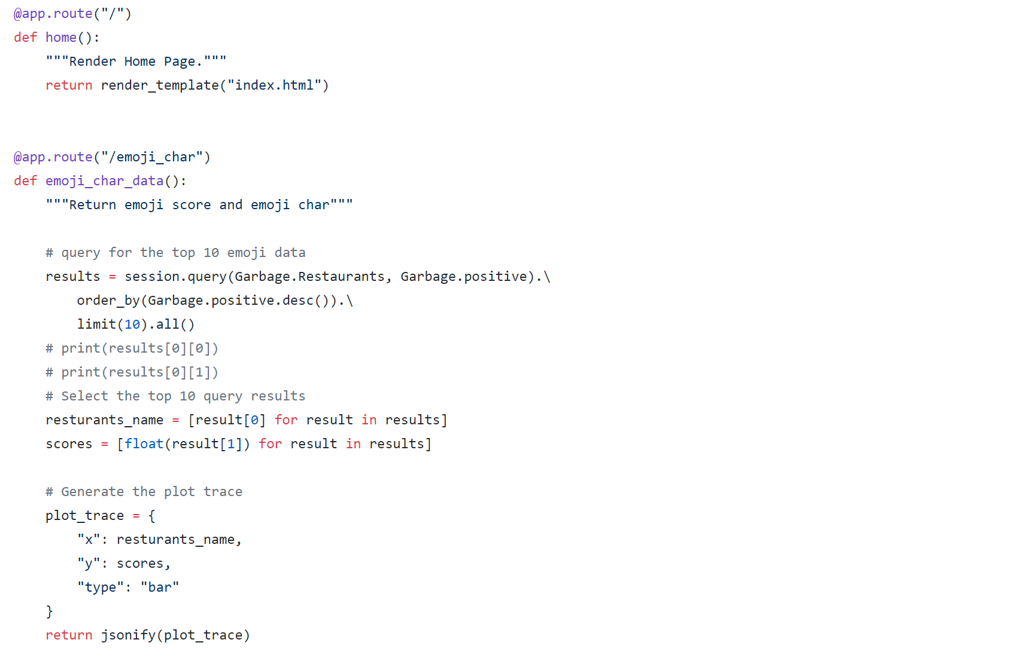
Data for plotly

Slide 8
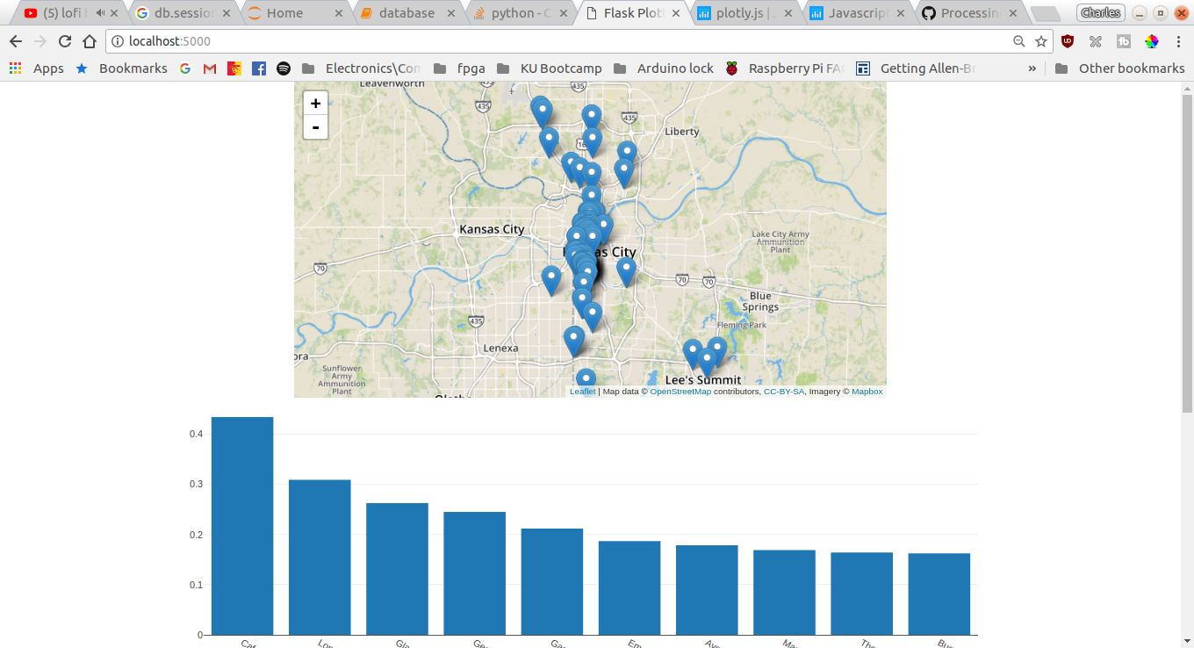
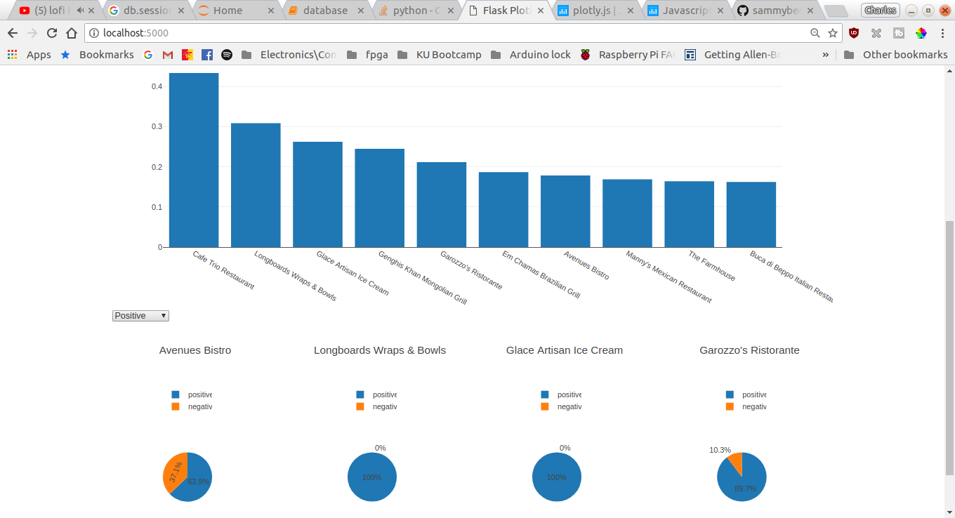
Web dashboard

